Slide 1
Generate Natural Language Explanations for Recommendation
ADVISOR: JIA-LING, KOH
SOURCE: EARS’19
SPEAKER: kuan-yu, sheng
DATE: 2020/02/24

Slide 2
Outline
Introduction
Method
Experiment
Conclusion

Slide 3
Introduction
3
A personal explainable recommender system.
80%
Recommend Rating
User latent factor
Item latent factor
Recommend Reason

Slide 4
Introduction
4
Training set
User set
Item set
Reviews
Rating
Feature words
80%
Toolkit
Vocabulary Feature words

Slide 5
Introduction
5
A personal explainable recommender system.
Personalize
Explainable
Recommondation
Notes:
Personalize是在training time

Slide 6
Outline
Introduction
Method
Experiment
Conclusion

Slide 7
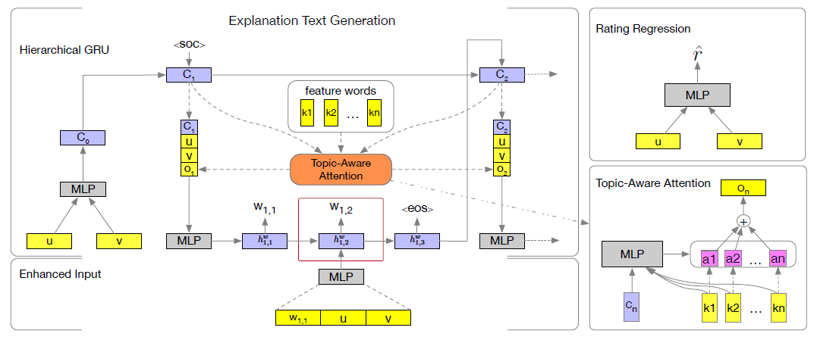
Method
7
Model over view
Recommendation
Explainable
Personalization

Slide 8
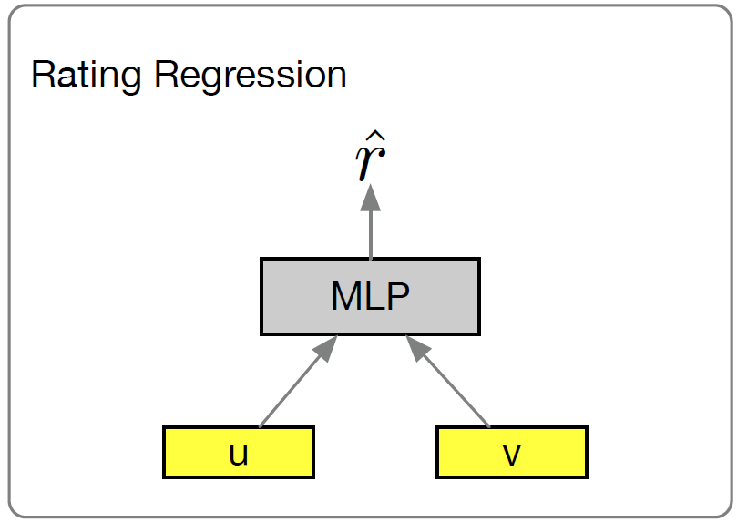
Method
8
Neural Rating Regression
MLP:
Input:
U : user latent vector.
V : item latent vector.
Output:
Rating scores
m : number of user.
n : number of item.
d : latent vector dimension.

Slide 9
Method
9
Neural Rating Regression
MLP:
loss:
Notes:
L可以很多層看情況(後面實驗就用4層)

Slide 10
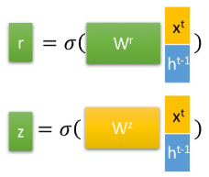
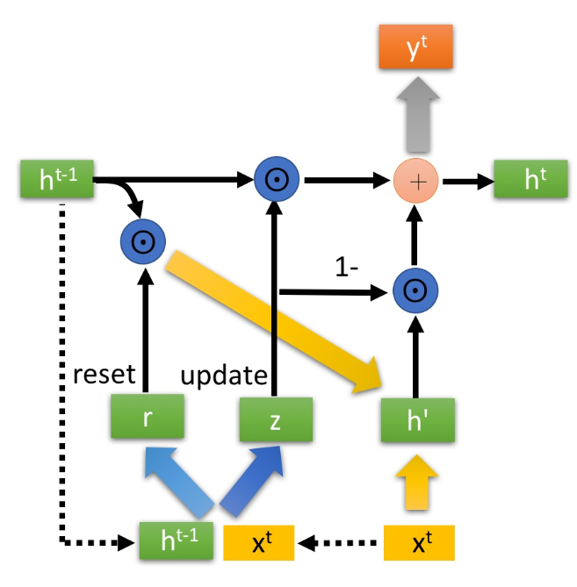
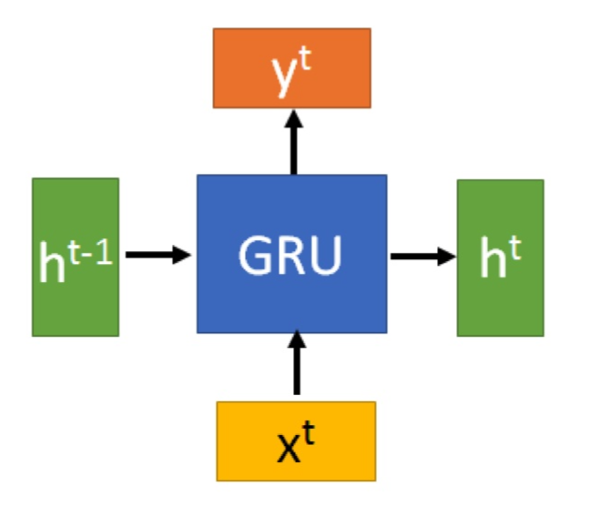
Method
10
Reset gate:
GRU
Update gate:
Result :

Slide 11
Method
11
Personalized Explanation Generation
Context-level GRU (GRUctx):
U : user latent factor
V : item latent factor
GRUctx
Ci : denotes a specific context representation.
Representation of n sentences

Slide 12
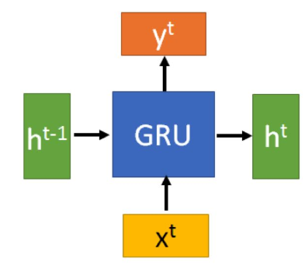
Method
12
Personalized Explanation Generation
GRUctx
$$h_{GRUctx}^{}$$
$$h_{GRUctx}^{}$$
$$h_{GRUctx}^{}$$
$$C_{0}$$
$$C_{2}$$
$$C_{1}$$
$$C_{1 }$$
$$C_{3 }$$
$$C_{1 }$$
$$C_{2 }$$
…..
$$<SOC>$$
$$h_{1, L}^{w}$$
$$h_{2, L}^{w}$$

Slide 13
Method
13
Personalized Explanation Generation
GRUctx
Context-level GRU (GRUctx):
u : User latent factor.
v : Item latent factor.
$h_{n−1, L}^{w}$: Last hidden state of GRUwrd.
$c_{n−1 }$: Previous context representation.

Slide 14
Method
14
Personalized Explanation Generation
GRUwrd
$$e_{n, t}$$
$$e_{n, t+1}$$
$$e_{n, t+2}$$
$$h_{n, t}^{w}$$
$$h_{n, t+1}^{w}$$
$$h_{n, t+2}^{w}$$
$$h_{n, t−1}^{w}$$
$$h_{n, 1}^{w}$$
$$h_{n, 2}^{w}$$
…..
$$W_{n, t−1 }$$
$$W_{n, t }$$
$$W_{n, t+1 }$$

Slide 15
Method
15
Personalized Explanation Generation
GRUwrd
Word-level GRU (GRUwrd) :
$c_{n }$: output of GRUctx.
$o_{n−1}^{}$: i -th sentence feature-aware attention context vector.
$h_{n−1, L}^{w}$: Previous hidden state.
$w_{n, t }$: Current input (previous output).

Slide 16
Method
16
Personalized Explanation Generation
GRUctx & GRUwrd
Data flow:
GRUctx
$c_{1 }$= f ($c_{0}$, $<SOC>$ )
GRUwrd
$h_{1, 0}^{w}$ = f ($c_{1}$,u ,v, $o_{1}^{}$ )
$h_{1 , 1}^{w}$
$h_{1, 2}^{w}$
$h_{1, L}^{w}$ = f ($h_{1, L−1}^{w}$ , $w_{1, L }$ )
,
,
,
…..
$c_{2 }$= f ($c_{1}$, $h_{1, L}^{w}$ )
$h_{2, 0}^{w}$ = f ($c_{2}$,u ,v, $o_{2}^{}$ )
$h_{2 , 1}^{w}$
$h_{2, 2}^{w}$
$h_{2, L}^{w}$ = f ($h_{2, L−1}^{w}$ , $w_{2, L }$ )
,
,
,
…..
$c_{n }$= f ($c_{n−1}$, $h_{n−1, L}^{w}$ )
…..
$h_{n, 0}^{w}$ = f ($c_{n}$,u ,v, $o_{n}^{}$ )
$h_{n , 1}^{w}$
,
…..
$h_{n, L}^{w}$ = f ($h_{n, L−1}^{w}$ , $w_{n, L }$ )
,
$h_{n, 2}^{w}$

Slide 17
Method
17
Personalized Explanation Generation
GRUctx
Context-level GRU (GRUctx):
u : User latent factor.
v : Item latent factor.
$h_{n−1, L}^{w}$: Last hidden state of GRUwrd.
$c_{n−1 }$: Previous context representation.

Slide 18
Method
18
Personalized Explanation Generation
GRUwrd
Word-level GRU (GRUwrd) :
$c_{n }$: output of GRUctx.
$o_{n−1}^{}$: i -th sentence feature-aware attention context vector.
$h_{n−1, L}^{w}$: Previous hidden state.
$w_{n, t }$: Current input (Not previous output).

Slide 19
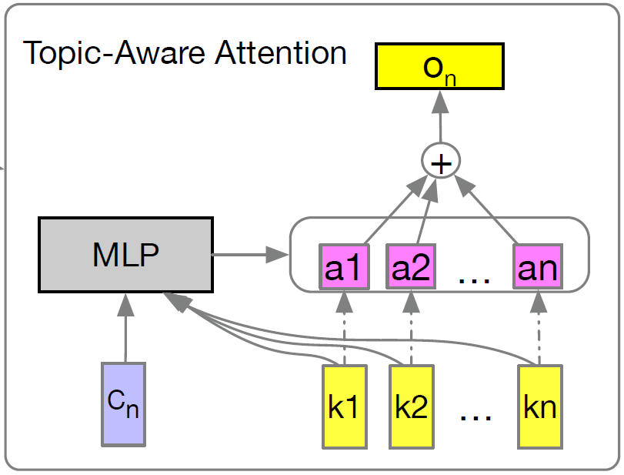
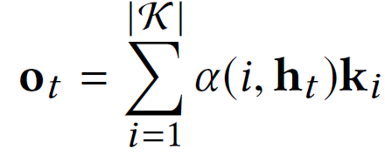
Method
19
Personalized Explanation Generation
Attention
Feature-aware Attention:
ht : hidden state of GRUctx.
ki : i-th feature-word embedding.
2d * 1
d * 1
d * 1
d * 2d
d * 1
1 * 1
1 * d
2d * 1
Notes:
所有feature word embedding根據feature word以及hidden state計算權重

Slide 20
Method
20
Personalized Explanation Generation
Word Generation
Word-level GRU (GRUwrd) :
$e_{n, t }$= current word vector representation .
The input vector of next state.

Slide 21
Method
21
Personalized Explanation Generation
Word Generation
Word-level GRU (GRUwrd) :
$c_{n }$= f ($c_{n−1}$, $h_{n−1, L}^{w}$ )
$h_{n, 0}^{w}$= f ($c_{n−1}$,u ,v, $o_{n−1}^{}$ )
$h_{n , 1}^{w}$
,
…..
$h_{n, L}^{w}$ = f ($h_{n, L−1}^{w}$ , $w_{n, L }$ )
,
$h_{n, 2}^{w}$
d * 1
d * 1
d * 1
…..
d * 1
$$h_{t=1}^{w}$$
$$h_{t=2}^{w}$$
$$h_{t=l}^{w}$$

Slide 22
Method
22
Personalized Explanation Generation
Word Generation
Word-level GRU (GRUwrd) :
Multinomial distribution over vocabulary V on review text.
Generate the next word by selecting the largest probability one.

Slide 23
Method
23
Personalized Explanation Generation
Loss of generation
Word-level GRU (GRUwrd) :
Loss function:
Testing stage:
Training stage:
Beam search
S :generated sequence
|S|:beam size.
$I_{w }$ = index of the word in the Vocabulary.

Slide 24
Method
24
Multi-task learning
Loss function:

Slide 25
Method
25
Personalized Explanation Generation
Auto-denoising:
The supervised factor of i-th sentence in the review.
k : set of the feature words.
Number of the feature words in i-th sentence.
Total number of the words in i-th sentence.
Notes:
Vocabulary
Toolkit Sentires

Slide 26
Outline
Introduction
Method
Experiment
Conclusion

Slide 27
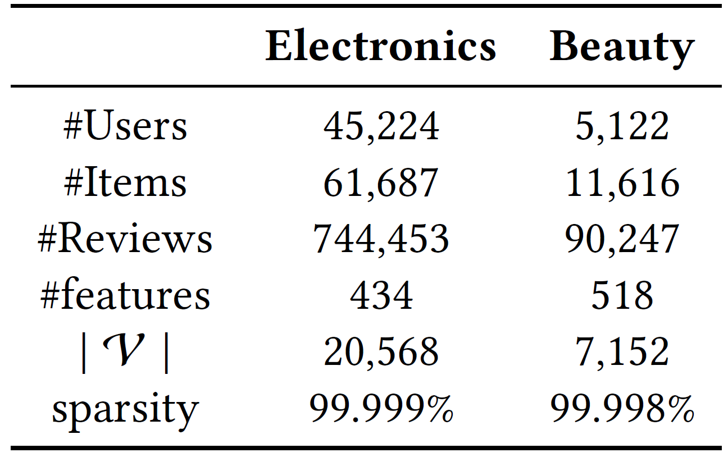
EXPERIMENT
27
Datasets
Notes:
Amazon ->May 1996 to July 2014
dataset covers 24 different categories we select Electronics and Beauty
filter the dataset at least 10 shopping records
For review text preprocessing, we keep all the punctuation and numbers in the raw text
dataset is noisy which is challenging for text
”Electronics” dataset contains 45,224 users,61,687 items, 744,453 reviews and 434 extracted feature
”Beauty” dataset contains 5,122 users,11,616 items, 90,247 reviews and 518 extracted feature
We filter the words with frequency lower than 10 to build the vocabulary
whole dataset is splited into three subsets: training, validation and testing (80%/10%/10%).

Slide 28
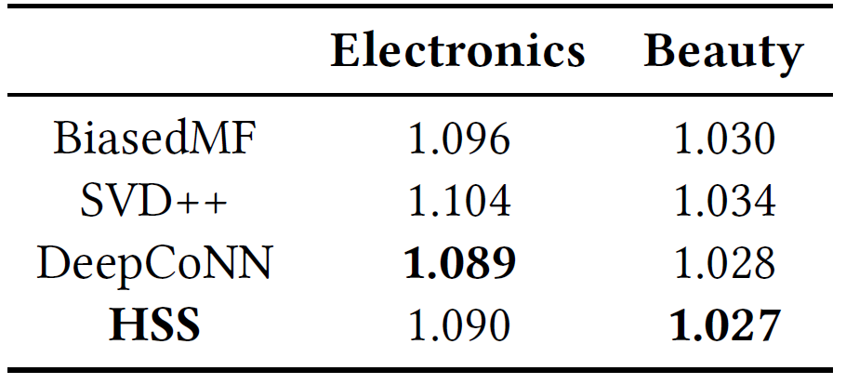
EXPERIMENT
28
Rating Regression Evaluation
RMSE values for rating regression
Notes:
first two methods only ratings information
third method involves user generated review for rating prediction.
MF: 用戶和商品矩陣來進行評分預測。
SVD:透過奇異值分解將潛在因子反饋到模型中。
DeepCoNN:可利用用戶評論信息來共同對用戶和物品進行建模。
在Beauty都贏
Deep跟HSS都強，是因為有用review，但雙方對review用法不一樣
Deep將review map到embedding 再捲積極池化到rating score.

Slide 29
EXPERIMENT
29
Explanation Sentence Generation Evaluation
BLEU-1 (B-1), BLEU-4 (B-4) and Feature words coverage(FC)
Notes:
Precision-base(預測中的對的多寡 )
BLEU主要任务是将候选翻译的n-gram与参考翻译的n-gram进行比较并计算匹配数。 这些匹配与位置无关。 匹配越多，候选翻译就越好。
number of feature words in the human reference texts is Nr
number of covered feature words in the machine generated sentences is Nc
how well our model generated sentences can capture the users personalized preferences.
also the measure of evaluate the explainability of the generated explanation sentences.

Slide 30
EXPERIMENT
30
Explanation Sentence Generation Evaluation
Notes:
It is a recall-related measure (真實情況被predict出來)
shows how much the words in the human reference texts appear in the machine generated text.
ROUGE-1(uni-gram), ROUGE-2(bi-gram), ROUGE-L(longest common subsequence) and ROUGE-SU4(skip gram)
好的原因:在文字生成時加入注意力機制可以讓生成的文字與原本的context更有關聯

Slide 31
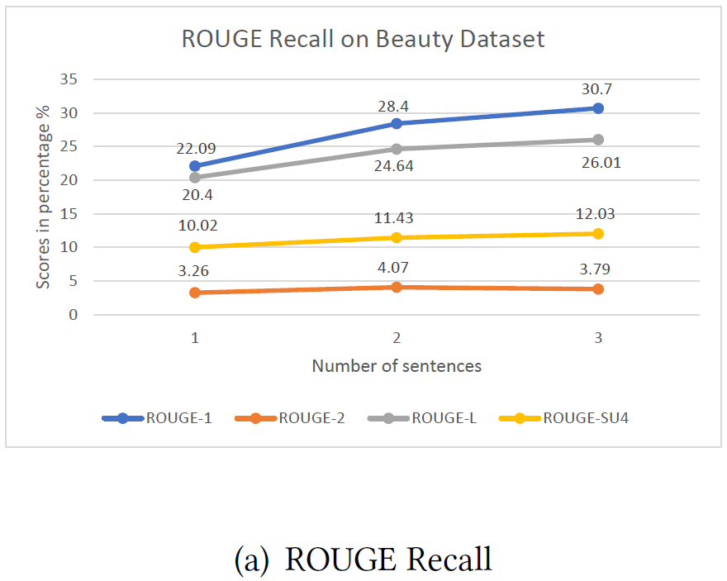
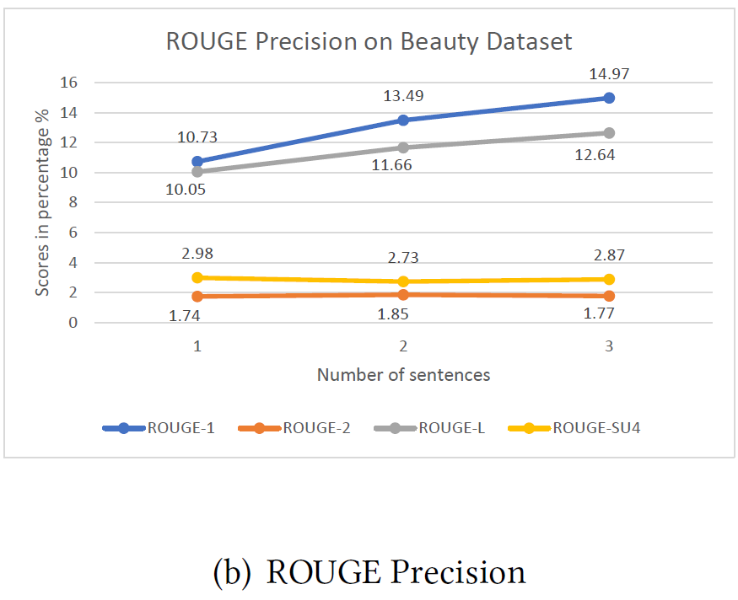
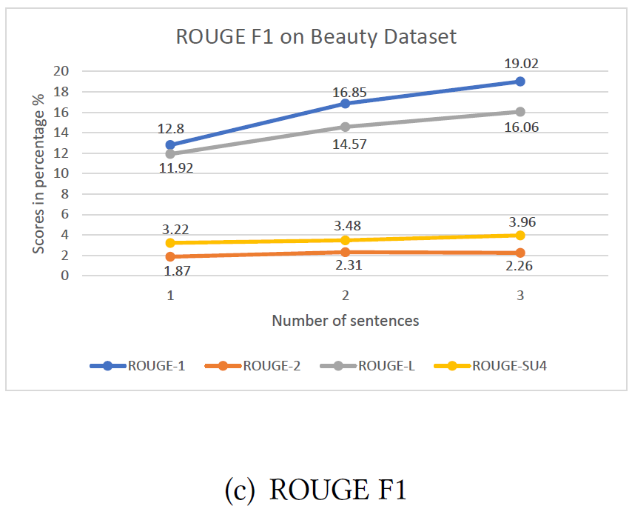
EXPERIMENT
31
Explanation Sentence Generation Evaluation
Notes:
多句子生成的準確度
生成越多句子表現越好

Slide 32
Outline
Introduction
Method
Experiment
Conclusion

Slide 33
Conclusion
Proposed a deep learning framework called HSS, can not only give accurate rating predictions but also generate explanation sentences.
For rating prediction, the model can achieve a comparable result to the state-of-art model.
For the explanation generation module, Proposed hierarchical GRU with feature-aware attention mechanism to generate personalized explanation sentences.
Also introduced an auto-denosing method to reduce the effect of unrelated sentences in training process.

